Slide 1
Medical Stock Interpretation–pre-Covid and the reclamation phase

Slide 2
Introduction
Medical logistics is the logistics of surgical, medical, and pharmaceutical supplies. It also includes the supplies of medical devices, medical and laboratory equipment, and other items, products, and pieces of equipment to support dentists, doctors, veterinary physicians, nurses, and other healthcare providers. With the raise in demand of these goods the pharma industry stocks ran bull, as their equity reached all time high values. These patterns can reveal the expected demand for a similar scenario in future. The trends in the pharma sector stock values provide highly valuable information, as the pre-covid and post-covid analysis of these stocks reveal that the pharma sector have benefitted the most from the pandemic. Our research aims to use LSTM model (Long Short-Term Memory)to interpret meaningful information from the pharma industry stock data and compare it with the trends of the other sectors.
Our model is not only about predicting the stock prices, but to obtain conclusion on the impact of pandemic on the finance sector.

Slide 3
Bread and Butter of stock analysis
The stock market indices (NIFTY and SENSEX)indicate the country’s wealth and the strength of the economy. The crash of the stock market indicates that there is a economical/political crisis prevalent in the country during that span of time. History has been repeating itself with repeated crashes once in a decade. In the year 2008 the world witnessed a crash with the crisis starting at Wall Street, which lead to the impact being experienced for several years. A simple analysis of the stock data taken during those periods would easily reveal that there must be an anomaly,which lead to the sudden dip in values. So using the same strategy to find out the underlying fact about the covid impacton economy,and how medical trends have been varying,we plan to use the data from 2019 to 2021, i.e pre-covid and the recovery phase of covid.

Slide 4
LSTM
Long Short-Term Memory (LSTM) networks are a type of recurrent neural network capable of learning order dependence in sequence prediction problems.

Slide 5
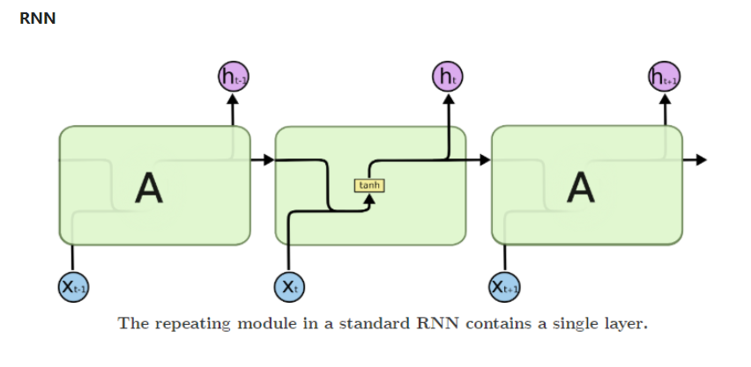
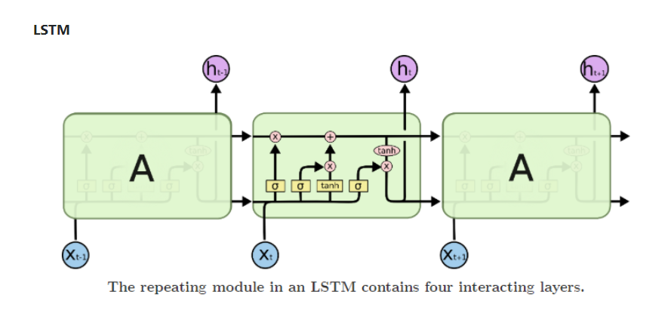
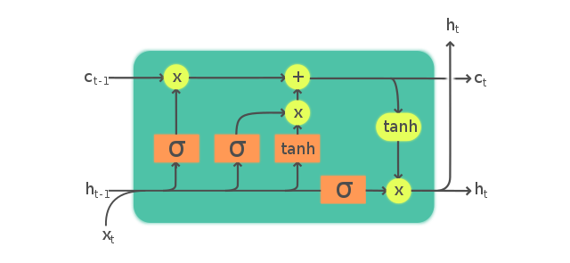
RNN
LSTM

